Slide 1
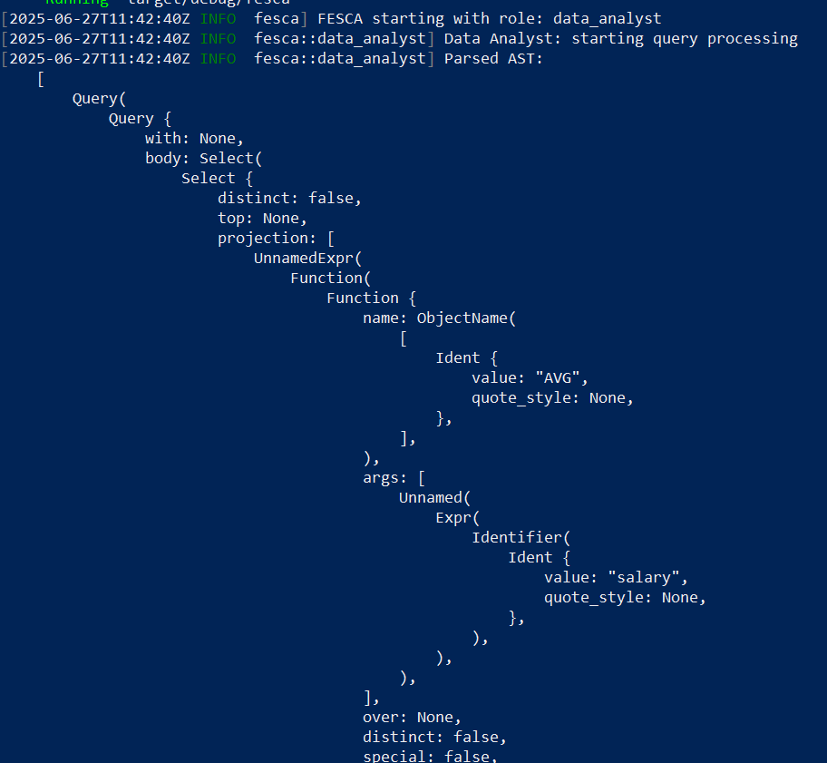


What has been done
Integrated SQL Parser into code
Tested on fixed hardcoded string “SELECT AVG(salary) FROM employees WHERE dept = 'R&D’;”
Generated Abstract Syntax Tree (AST, on the right) of this hardcoded statement
Extracted logical execution plan of this hardcoded statement (logical statements highlighted red)

Slide 2
Open questions / problems
Are we allowed to create databases on DM-servers?

Slide 3
Next steps
(if allowed) Generate dummy database stored on zs1 computing server to test parser on real datasets
Define physical operations (oblivious select, oblivious join, functions like AVG, etc.) on abstract level (next week)
Translate logical plan (which is sql-native) into physical plan (oblivious operations) (next 2 weeks)
Define physical operations using MPC primitives (requires collaboration with Alisher and Denis)

